Slide 1


Team Members: Awais Asghar Muhammad Ashar Javid Muhammad Hammad Sarwar Huzaifa Ahmed

Slide 2
Results
Boosted trees Accuracy: 68% (Performs exceptionally well on International)
KNN Accuracy: 71% (Performs exceptionally well overall)
SVM Accuracy: 65.5% (Performs exceptionally well on Hiphop)
CNN Accuracy: 49.75% (Performs exceptionally well on Folk)

Slide 3
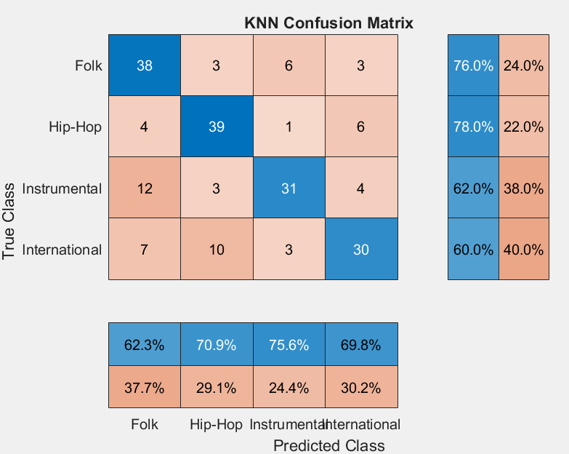
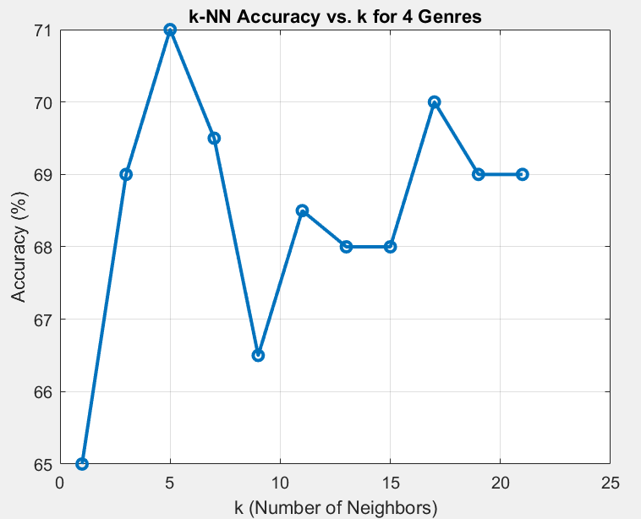
KNN Results:

Slide 4
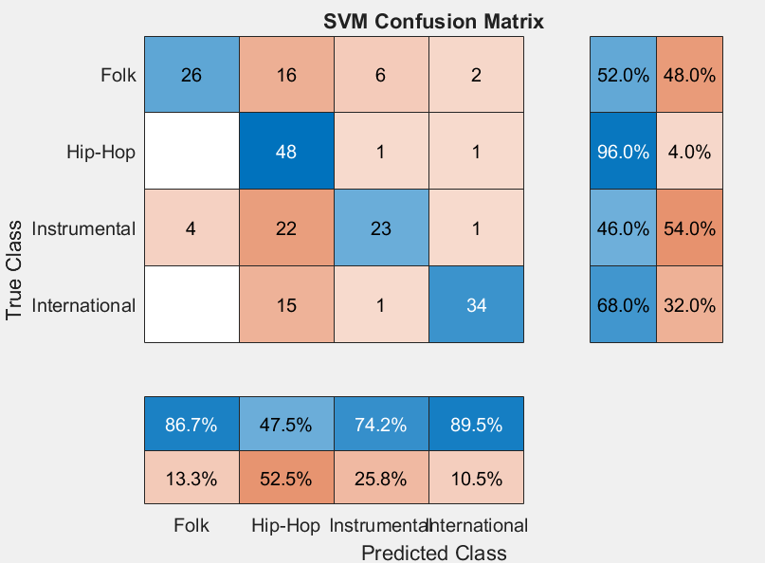
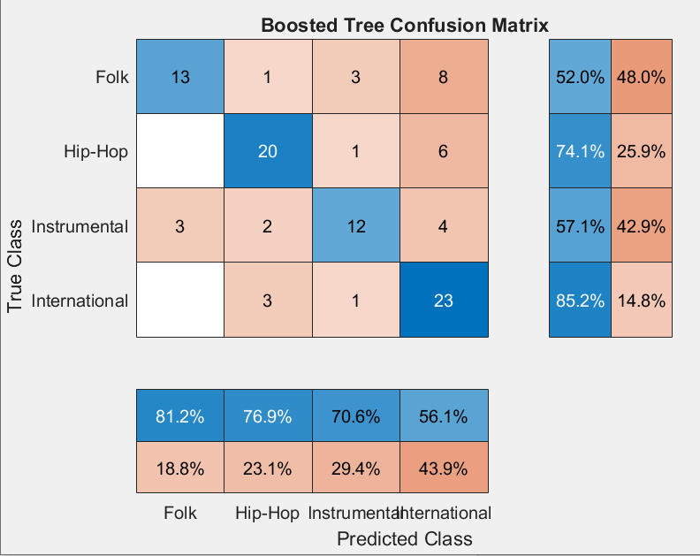
SVM & Boosted Trees Results

Slide 5
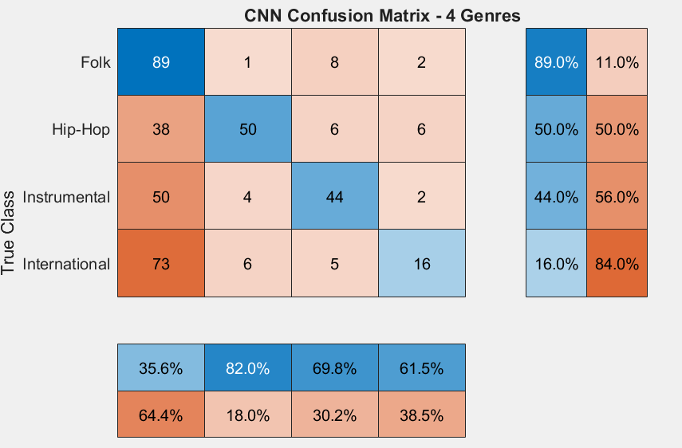
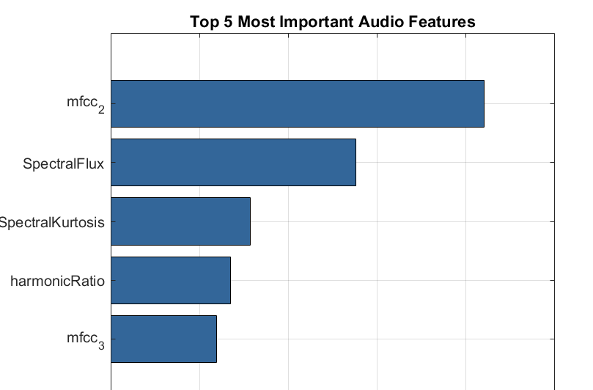
CNN & Top Features

